Slide 1

International remote working policy
KPMG Abogados, S.L.P.
  —
  February 10th, 2026

Slide 2
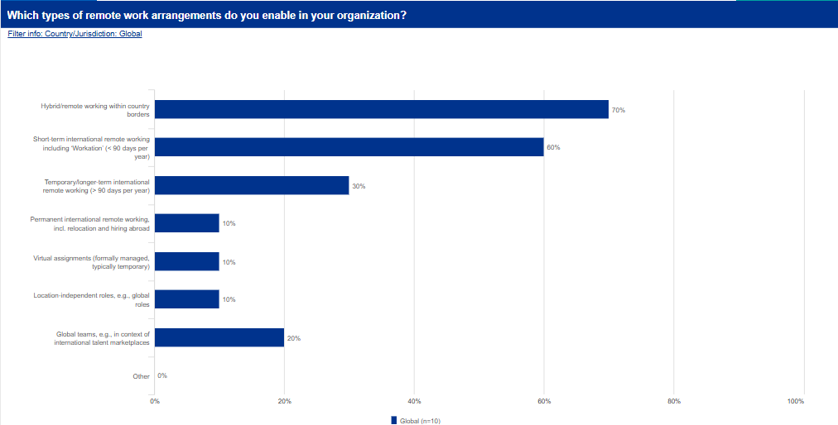

Slide 3
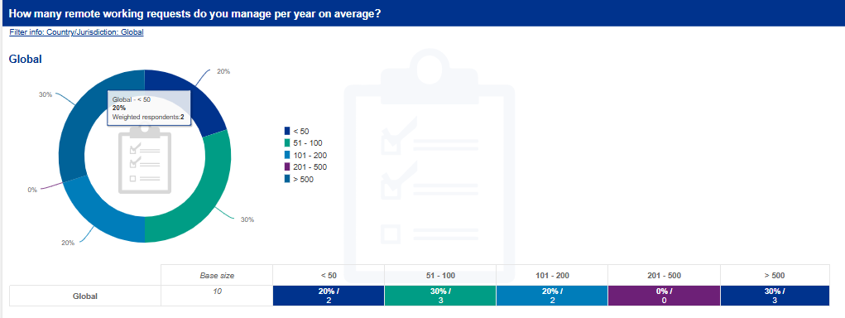

Slide 4
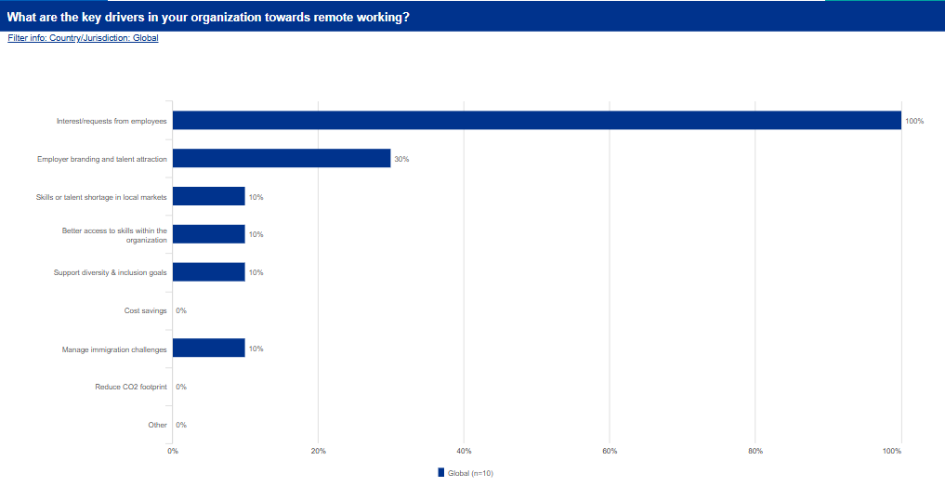

Slide 5
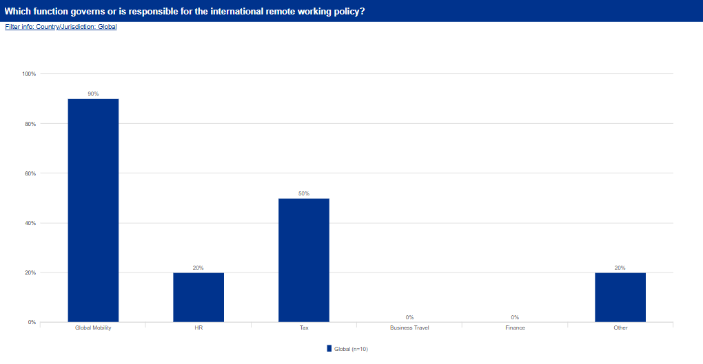

Slide 6
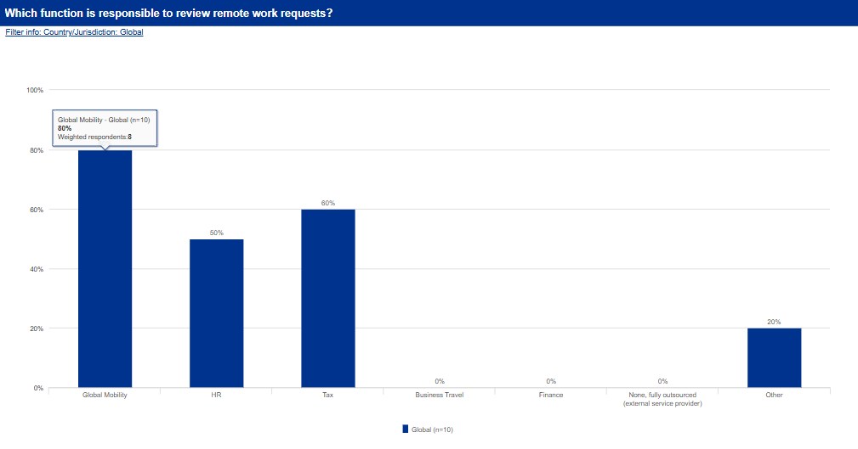

Slide 7
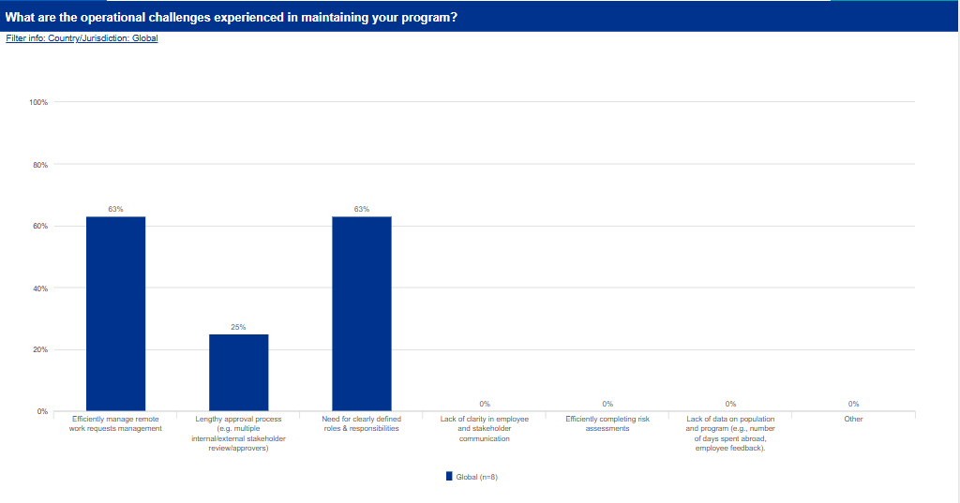

Slide 8
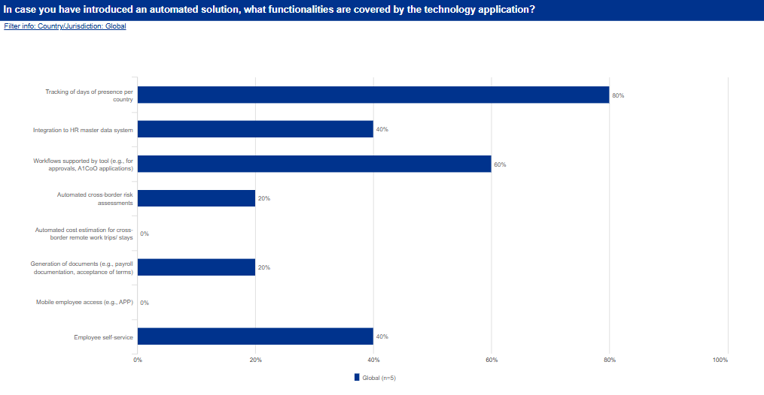

Slide 9
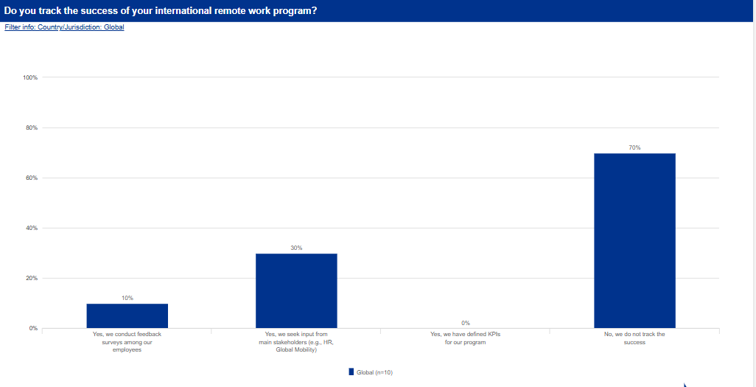

Slide 10

Short term international remote work

Slide 11
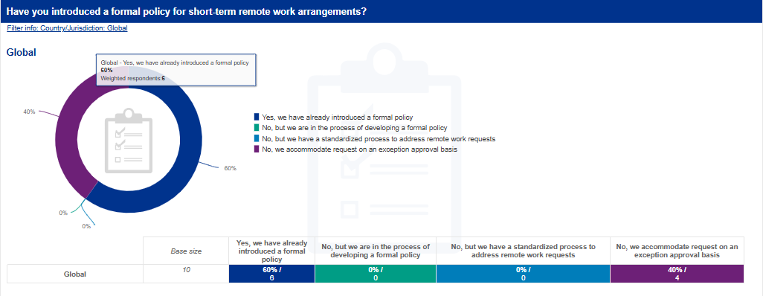

Slide 12
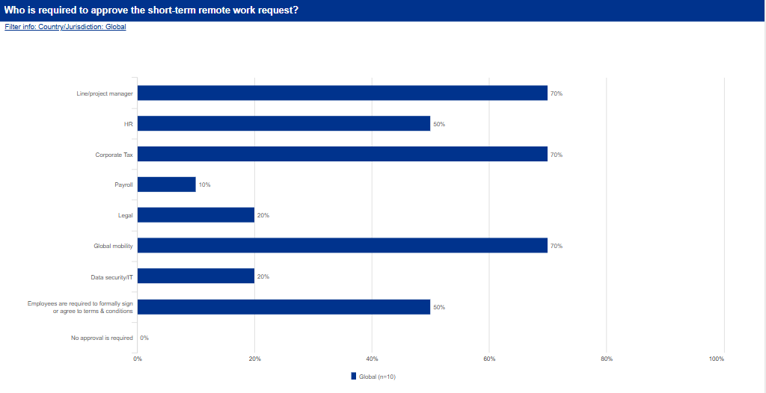

Slide 13
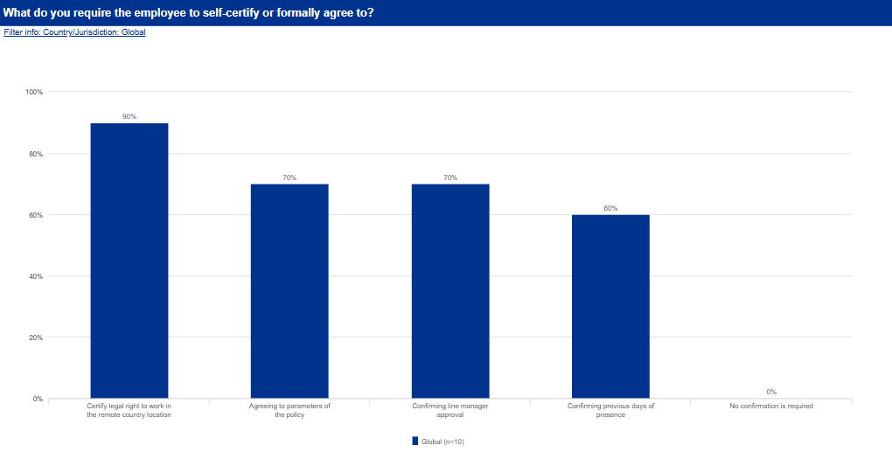

Slide 14
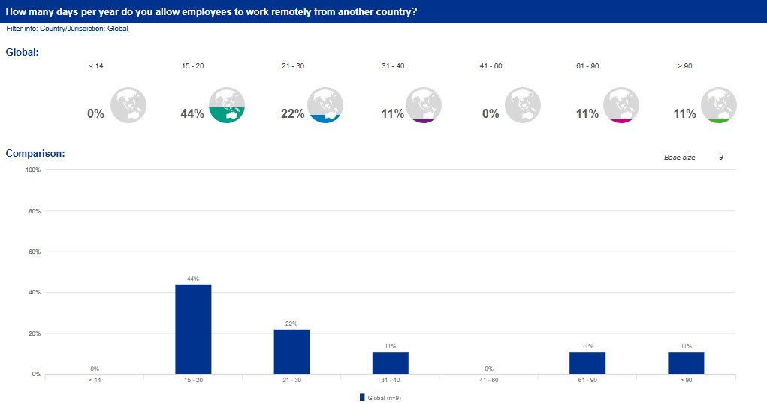

Slide 15
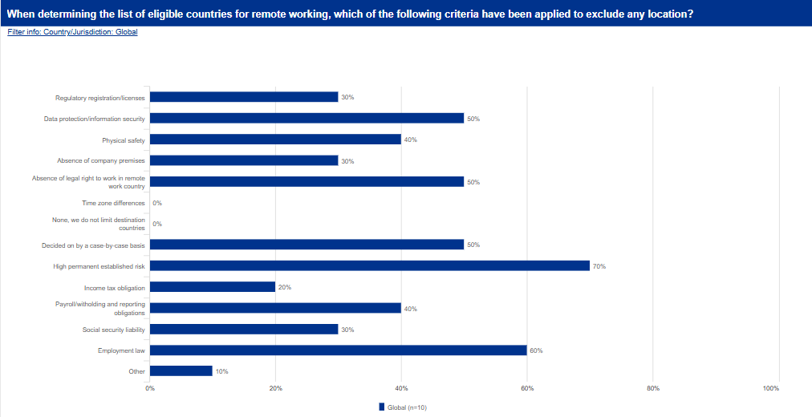

Slide 16
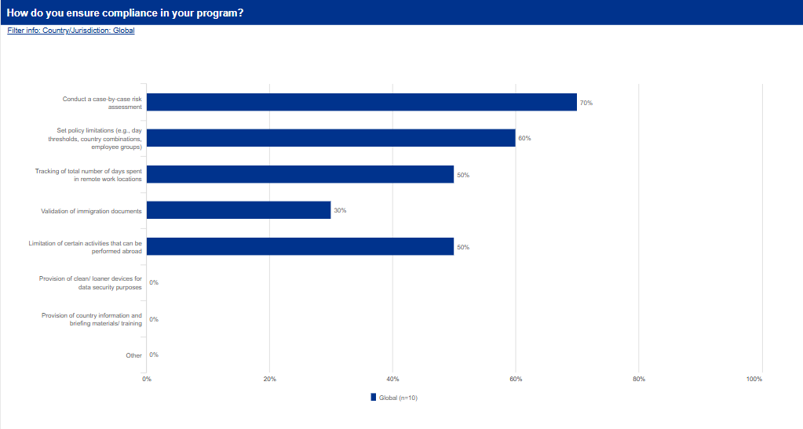

Slide 17
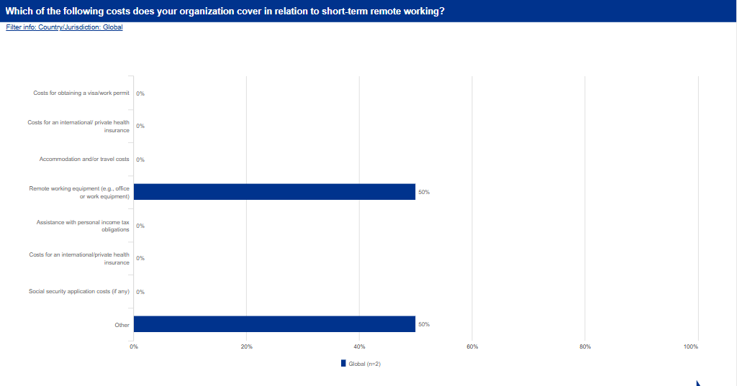

Slide 18
Long-term international remote work

Slide 19
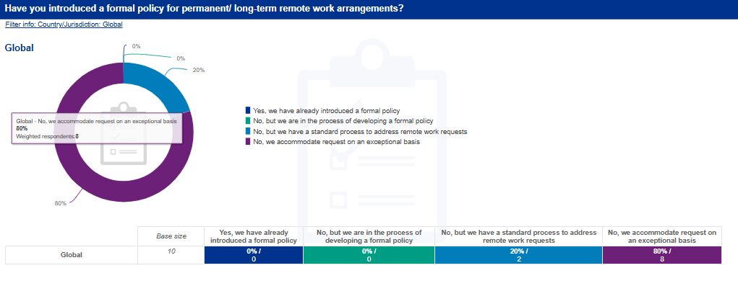

Slide 20
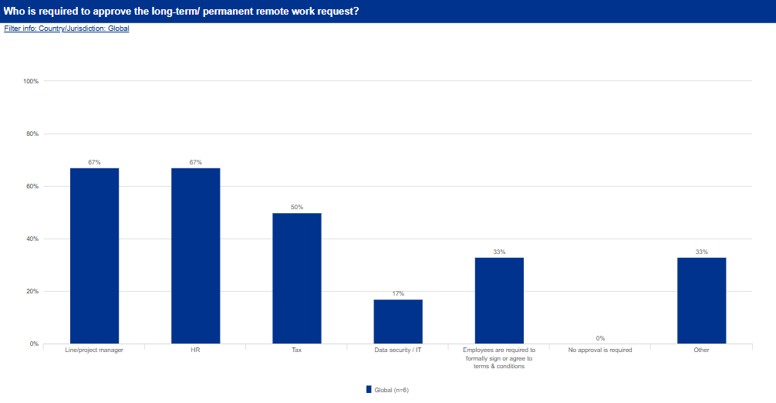

Slide 21
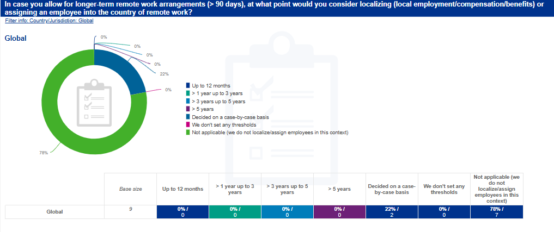

Slide 22
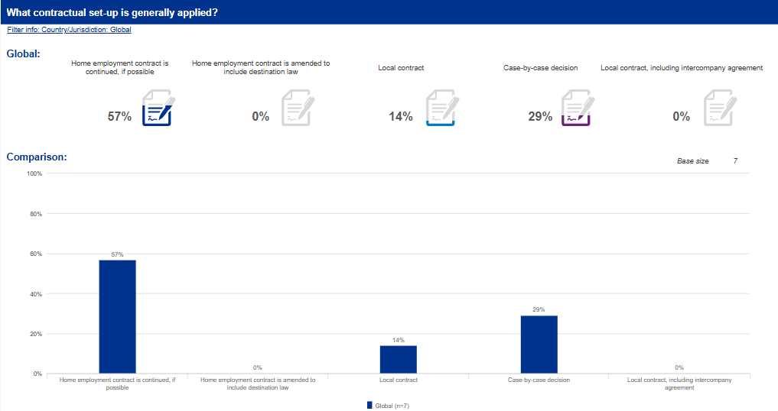

Slide 23
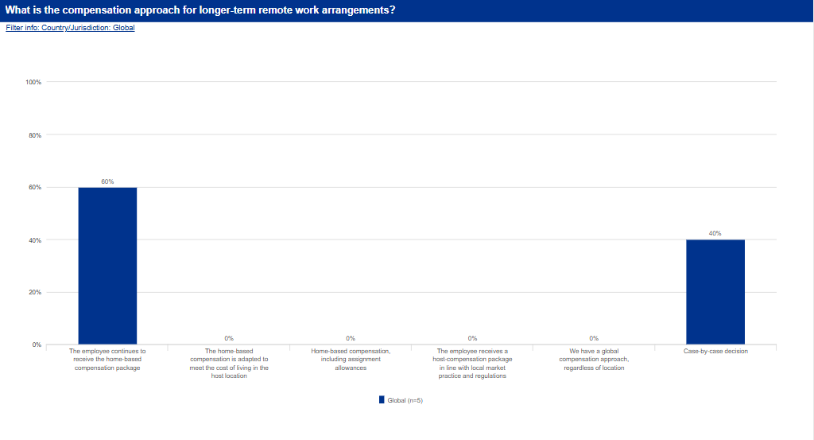

Slide 24
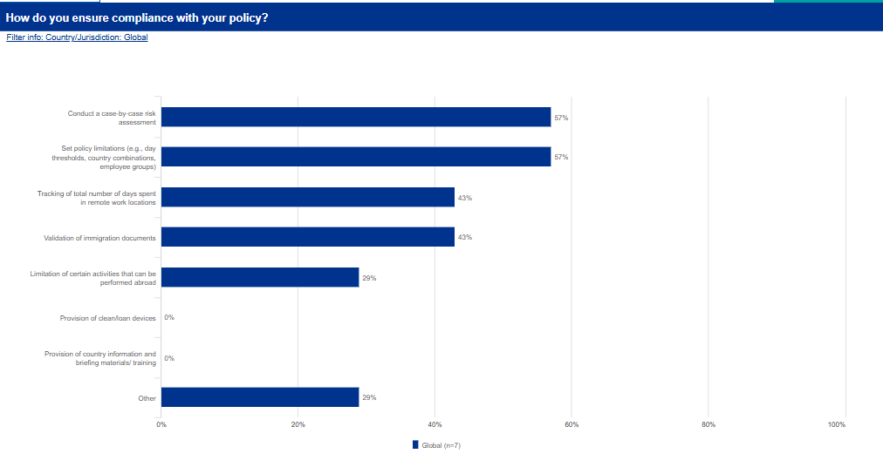

Slide 25
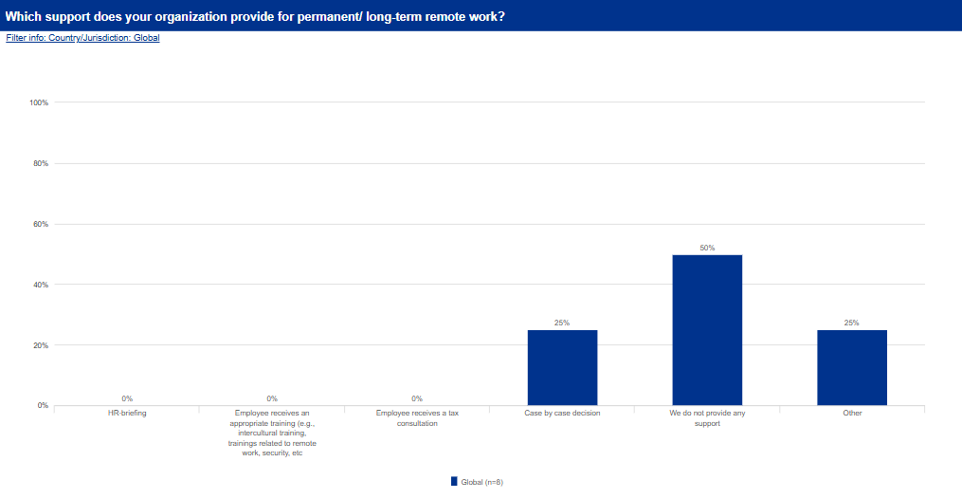

Slide 26






kpmg.es
The information contained herein is of a general nature and is not intended to address the circumstances of any particular individual or entity. Although we endeavor to provide accurate and timely information, there can be no guarantee that such information is accurate as of the date it is received or that it will continue to be accurate in the future. No one should act on such information without appropriate professional advice after a thorough examination of the particular situation.
© 2026 KPMG Abogados S.L.P., a professional limited liability Spanish company and a member firm of the KPMG global organization of independent member firms affiliated with KPMG International Limited, a private English company limited by guarantee. All rights reserved.
The KPMG name and logo are trademarks used under license by the independent member firms of the KPMG global organization.

